Slide 1
Milestone VI.
Tarsoly Levente

Slide 2
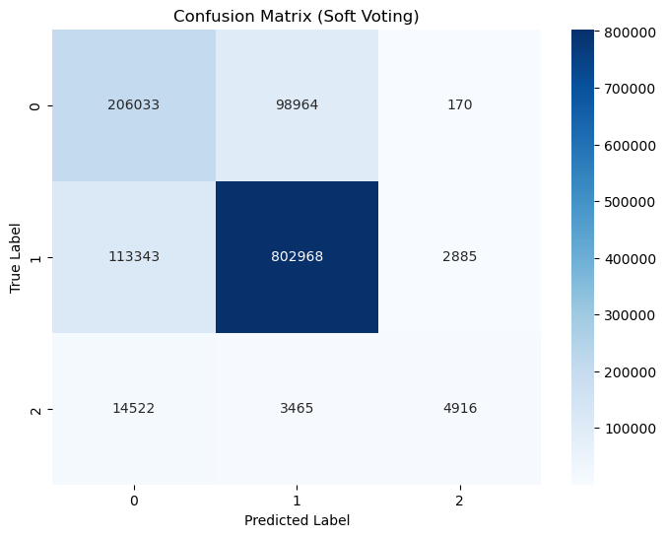
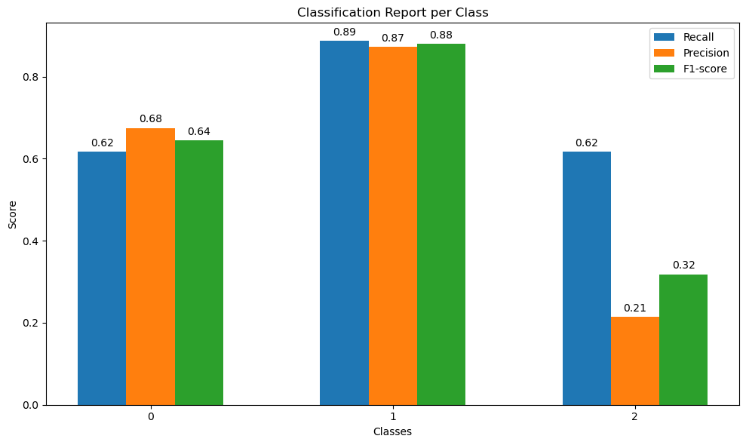
Soft Voting C-n
Accuracy: 0.8129116002520713
Precision: 0.7068859300752838
Recall: 0.5877824821099569
F1-Score: 0.6133

Slide 3
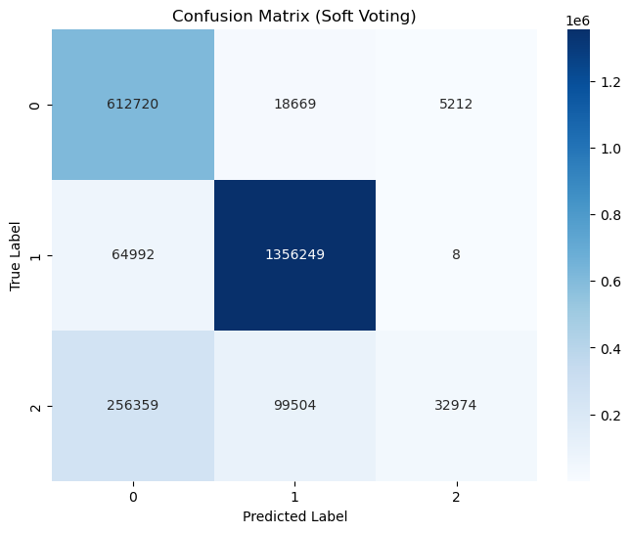
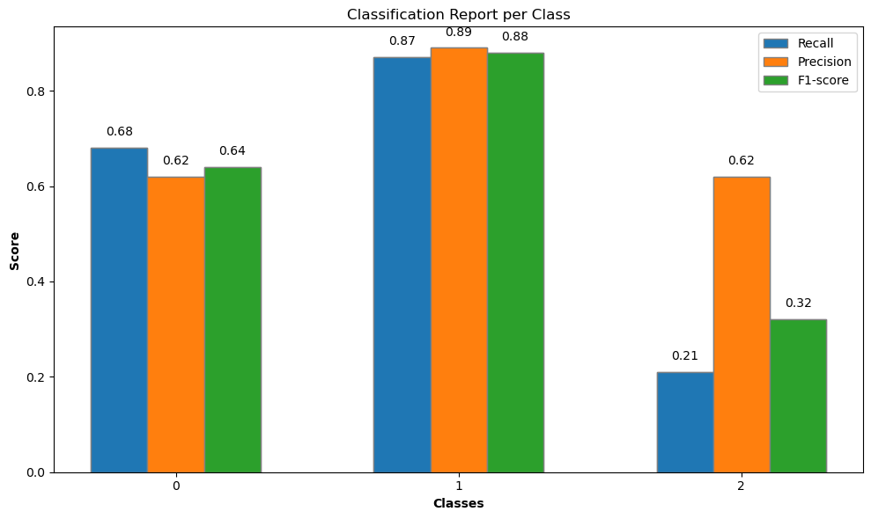
Soft Voting D-n
Accuracy: 0.8182
Precision: 0.8130
Recall: 0.6672
F1-Score: 0.6237

Slide 4
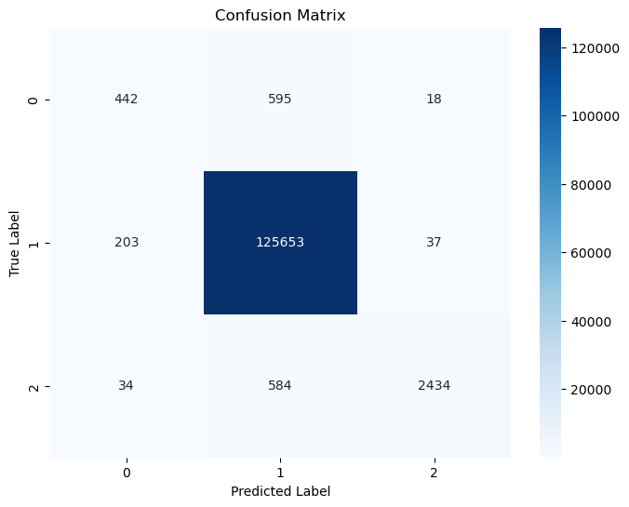
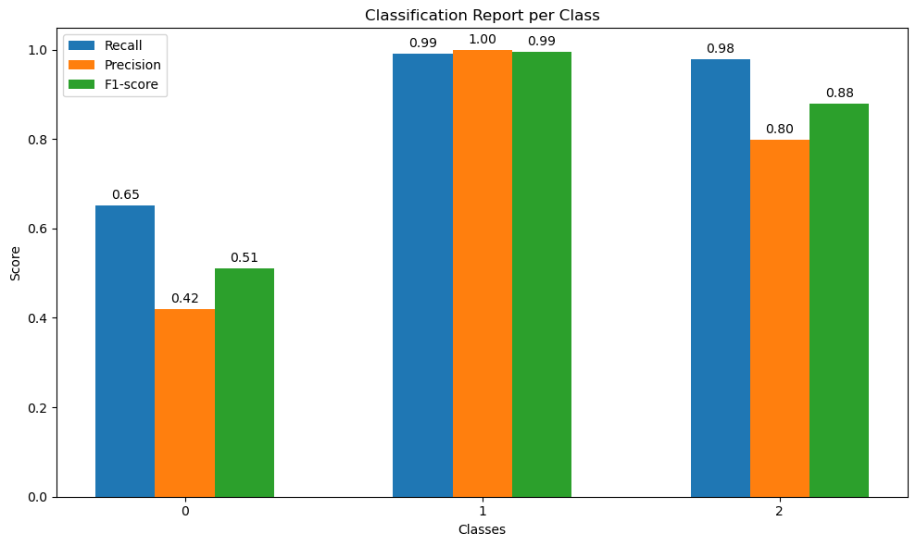
RFC aggregáció nélkül C-n
Accuracy: 0.9887
Precision: 0.74
Recall: 0.87
F1: 0.7933

Slide 5
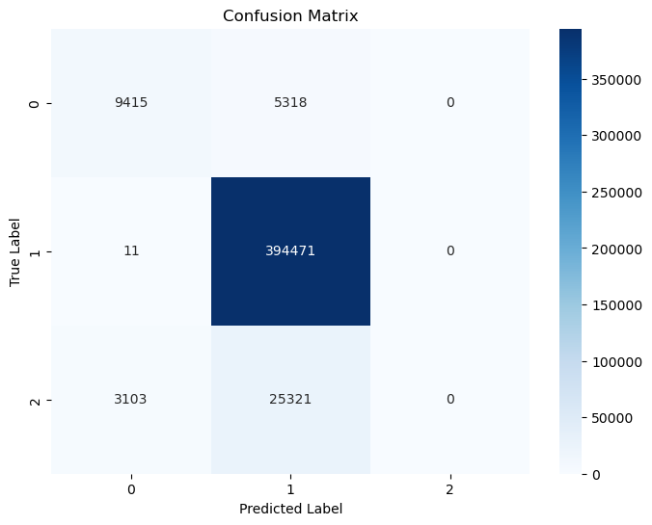
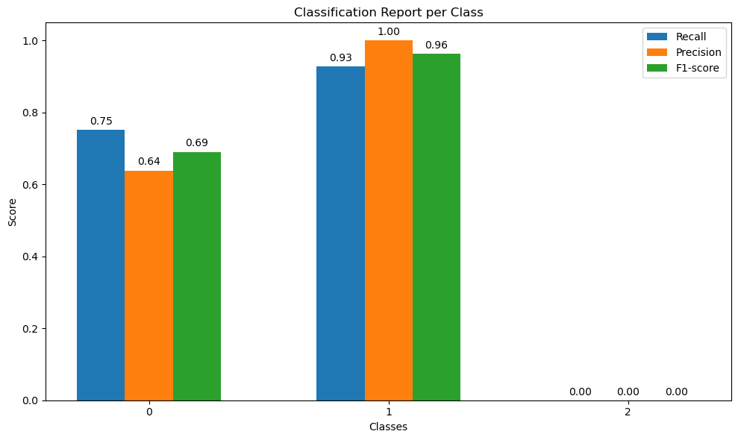
RFC aggregáció nélkül D-n
Accuracy: 0.9886846153846154
Precision: 0.8731881003360513
Recall: 0.7381869315920103
F1: 0.5500

